Slide 1
Text Detection in Images using OpenCV and TFlite
By Donald Aingworth IV
Project for OpenAvenues

Slide 2

OpenCV
Computer Vision Tool
Reads Images for Analysis
Allows for marking digital images
Compatible with Python, C++, Java, etc

Slide 3

TensorFlow/TFlite
Machine Learning Tool
Allows for small storage of algorithms
Used to analyze images and detect patterns of text within them
Used EAST model

Slide 4
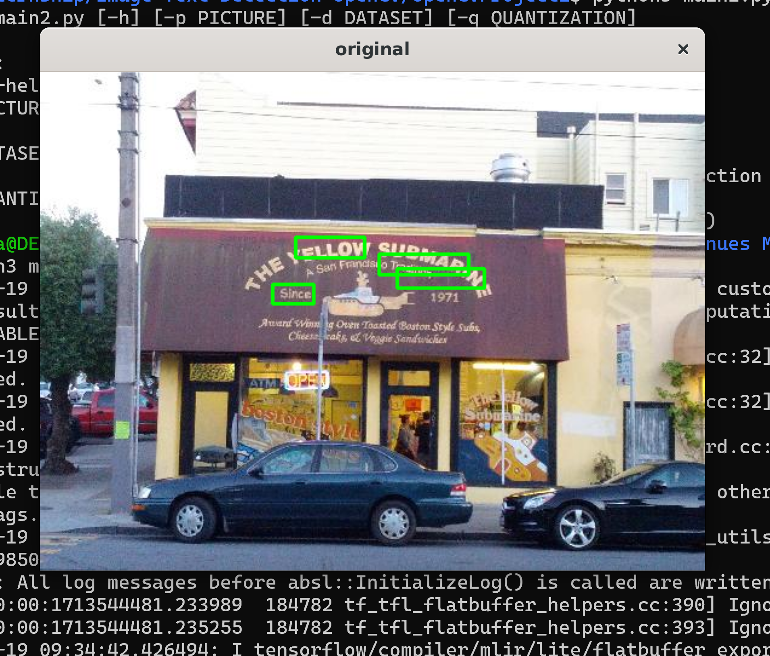
The Project Itself
Runs from terminal
Customizable input
Creates a tool for image analysis
Checks input image for text
Surround text in image with rectangles

Slide 5
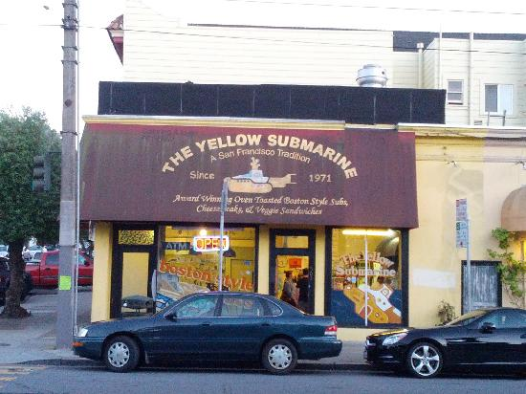

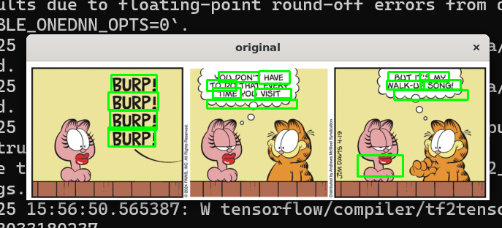

BEFORE | AFTER

Slide 6
python3 OpenCVProject2.py
-p --picture | Select the photo you want to analyze for text If no picture is mentioned, default is a picture of a sandwich shop
-d --dataset | Select the dataset to use as a basis for text detection By default, it will use a dataset of 100 images
-q --quantization | Select the unit of quantization Options: dr, int8, and float16 By default, it will be int8

Slide 7
Next Steps
Change code to C++
Make compatible with Windows Command Prompt
Make README more intricate

